Slide 1
Welcome To My Presentation

Slide 2
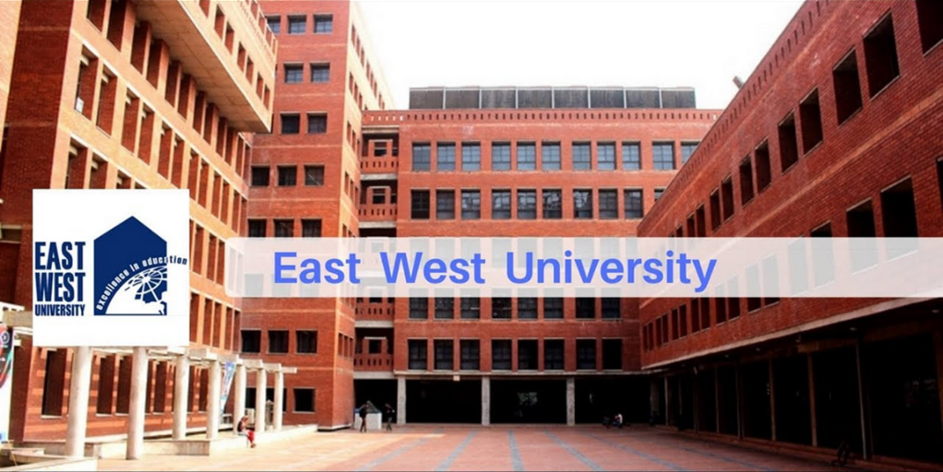
Introduction of myself
Name : Md.Abu Zafor
ID : 2020-2-60-158
Sec : 04
CSE Department

Slide 3
Fall 2021 MAT-104 Co-ordinate Geometry and Vector Analysis Guided By Dr.A. K. M. Nazimuddin Assistant Professor Department of Mathematics & Physical Science

Slide 4
VECTOR ALGEBRA

Slide 5
What is vector ?
A quantity that has magnitude, as well as direction, is called a vector.
P(x,y,z)

Slide 6
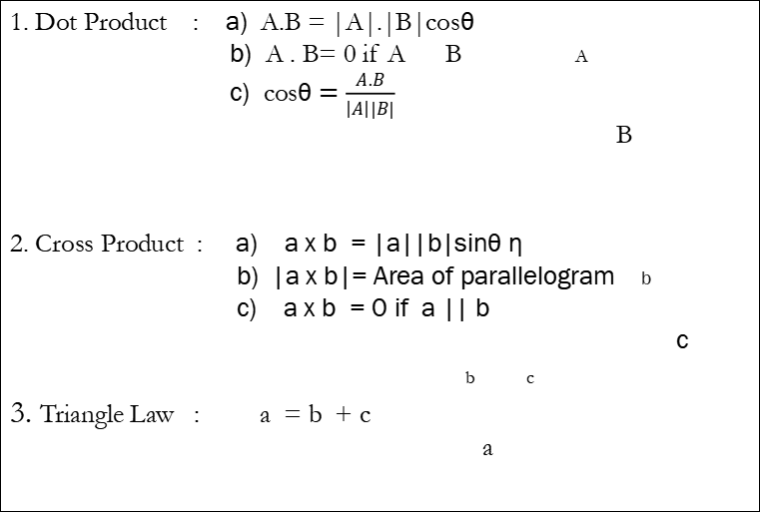
Properties of Vector Algebra : -
1. Dot Product : a) A.B = |A|.|B|cosθ
b) A . B= 0 if A B A
c) cosθ $=\frac{A.B}{\left|A\right||B|}$
B
2. Cross Product : a) a x b = |a||b|sinθ η
b) |a x b|= Area of parallelogram b
c) a x b = 0 if a || b
c
b c
3. Triangle Law : a = b + c
a

Slide 7
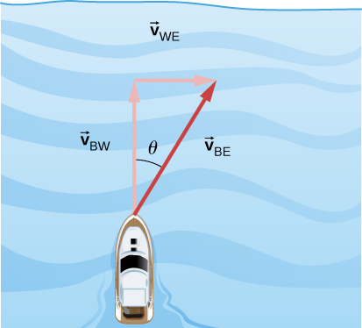
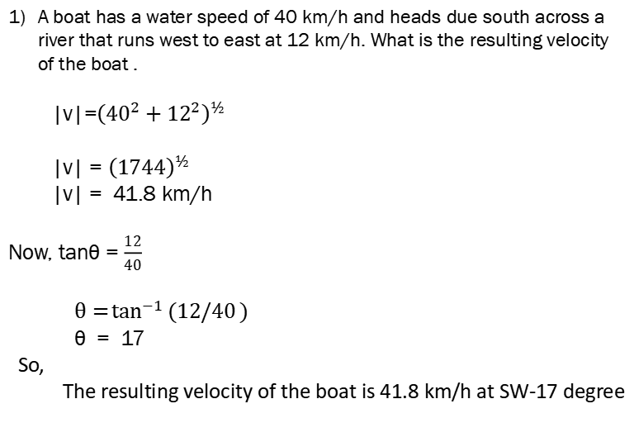
Examples : -
A boat has a water speed of 40 km/h and heads due south across a
river that runs west to east at 12 km/h. What is the resulting velocity
of the boat .
|v|=${\left({40}^{2}+{12}^{2}\right)}^{½}$
|v| = ${\left(1744\right)}^{½}$
|v| = 41.8 km/h
Now, tanθ = $\frac{12}{40}$
$θ=\tan^{−1}{(12/40})$
θ = 17
So,
The resulting velocity of the boat is 41.8 km/h at SW-17 degree
12 km/h
40 km/h

Slide 8
Applications Of Vector Algebra In Real
Life

Slide 9
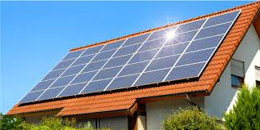
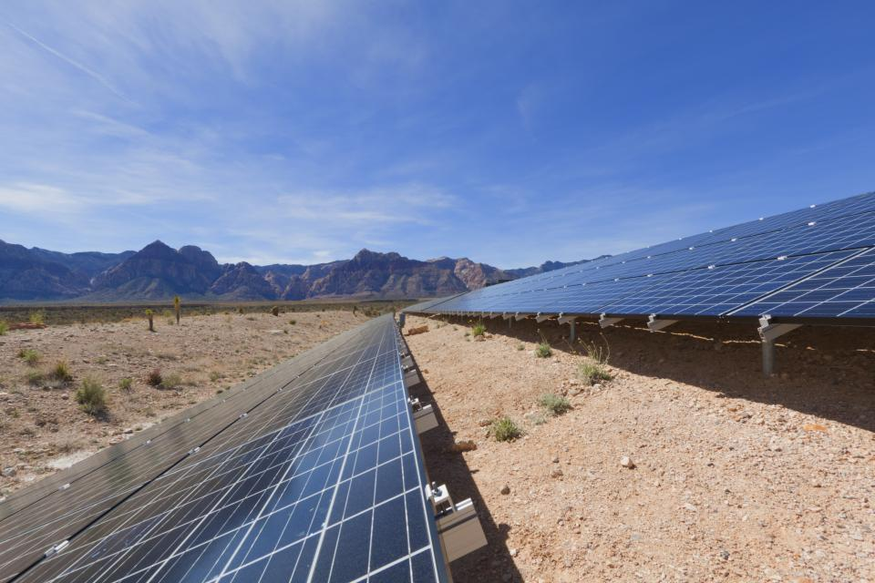
Using of vector for conserving solar power :
A
B

Slide 10
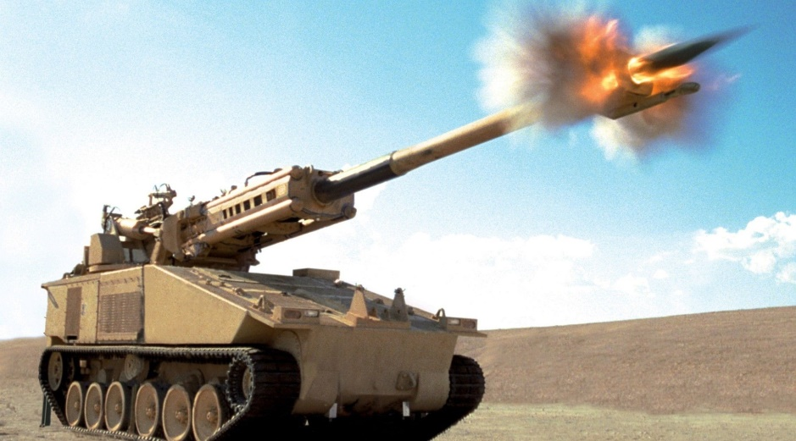
Using of vector’s in military weapons :

Slide 11
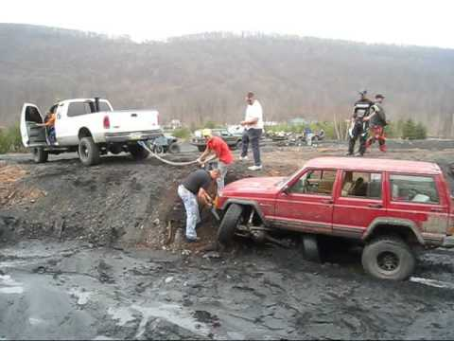
Using of vector algebra in tow truck :

Slide 12
THANK YOU

